Slide 1

Python Heterodyne Measurement Automation
Thomas Keyes
Computer Engineering, University of Virginia
axx2xu@virginia.edu

Slide 2
Program Highlights
Automatically adjusts the wavelength of lasers 3 and 4 to find the first measurement beat frequency as defined by the user
After calibrating the initial measurement state, the program determines the step size to loop from the user defined start and end beat frequency based on the input number of steps
Automatically selects the electrical spectrum analyzer for beat frequency measurements under 50 GHz
Automatically selects the wavelength meter for beat frequency measurements at or above 50GHz
Reads in data from user defined s2p files to add calibrated RF power data to the raw data
Reads in data from user defined excel sheet with beat frequency and RF loss to add calibrated RF power data to raw data
Equipment Used
Anritsu ECL Lasers 3 and 4
The program adjusts the wavelength
HP ESA 8565E/Newport Commercial PD
Program reads beat frequency < 50 GHz
HP Wavelength Meter 86120C
Program reads beat frequency >= 50 GHz
KEOPSYS Optical Amplifier (EDFA)
Program does not use
Agilent Attenuator 81577A (VOA)
Program reads P actual
Keithley Source meter 2400-C (High Power 3)
Program reads photocurrent
Rohde & Shwarz Power Meter NRP-Z58
Program reads RF power up to 110GHz frequency

Slide 3
Program Overview
Program Process
Prompt user for input settings and loss files
After pressing “START” prompts the user for save location
Calibrates laser 3 and 4 to a user-specified threshold of starting beat frequency
Iterates through a user-specified number of steps between start and stop beat frequency while measuring beat frequency, photocurrent, and RF power
Updates live plots of beat frequency vs. step, photocurrent vs. beat frequency, and Raw RF power vs. beat frequency during the loop
Saves data to .txt, .xlsx, and .png format for later use
User Inputs in Program
Starting wavelength for laser 3 and laser 4
Start and end beat frequency (GHz)
Number of steps to take between start and end beat frequency
Delay time between updating lasers and taking new measurements (recommended minimum 3s)
RF Link Loss data (.s2p)
RF Probe Loss data (.xlsx)
Save information
File name and location
Device number
Trial comments
Necessary Manual Inputs and Adjustments
Turn on all equipment
Turn on Delta WL mode on Wavelength Meter
Zero R&S Power Meter using Power Viewer Software
Enable lasers, set output power
Enable Keithley Source meter – set output voltage and current threshold
Enable optical amplifier and turn on pump
Enable VOA and adjust attenuation to desired photocurrent
https://github.com/axx2xu/heterodyne

Slide 4
User Input: Laser 3/4 WL, Start/Stop Frequency, Step Count, Delay, Calibration Threshold
Repeat N times (where N is the number of steps between the start and stop frequency)
Initial State:
Program Sets ECL Lasers to Start Freq
Read Beat Frequency
After N iterations
Freq >= 50 GHz (WLM)
Read RF Power
Perform Calibration
(PC, Python)
Set Wavelength (ECL)
Freq < 50 GHz (ESA)
Read Beat Frequency
Data Acquisition (PC, Python)
Waveform Plots (PC)
Channel 3 (static)
Channel 4 (dynamic)
Read I_pd and
Apply Reverse Bias Voltage
(Keithley)
.txt, xlsx, .png Output (PC)
Amplify Signal (EDFA)
Attenuate Signal (Attenuator)
Testing PD

Slide 5
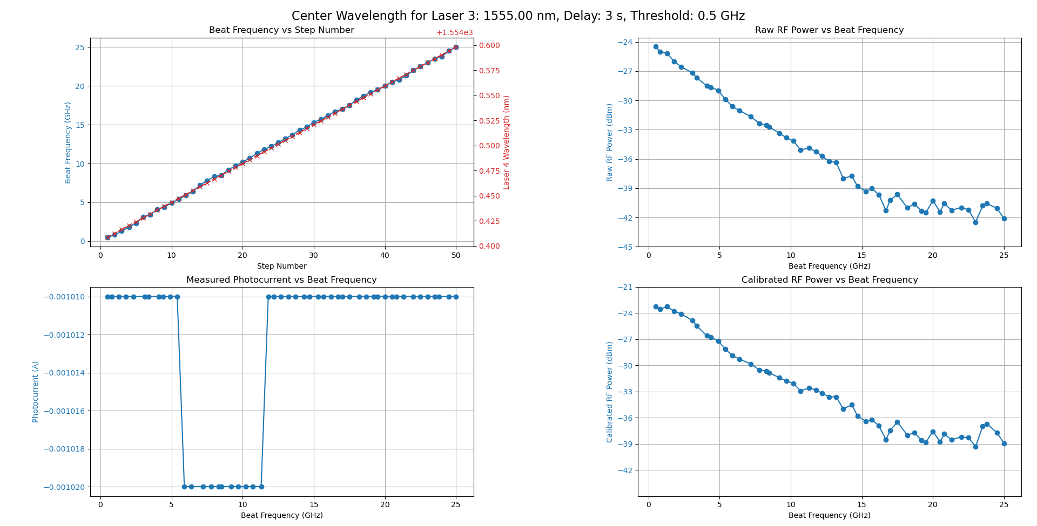
Program Output
Output Plots
The output plots contain four plots:
Beat frequency vs. step number – this is useful to see if the laser and steps and beat frequency measurements are updating reasonably
Measured photocurrent vs. beat frequency – used to visualize changes in the photocurrent reading from the Keithley
Raw RF Power vs. Beat Frequency – plots the rf power vs. beat frequency live as the measurement loop runs
Calibrated RF Power vs. Beat Frequency – once the measurement loop is finished the raw RF data is combined with the calibrated RF loss and re-plotted
*The red, right-side y-axis of the beat frequency vs. step number shows the wavelength at which laser 4 was set, as erratic points often occur in similar areas of wavelength. To get the value, add the value of the y-axis to the value at the top

Slide 6
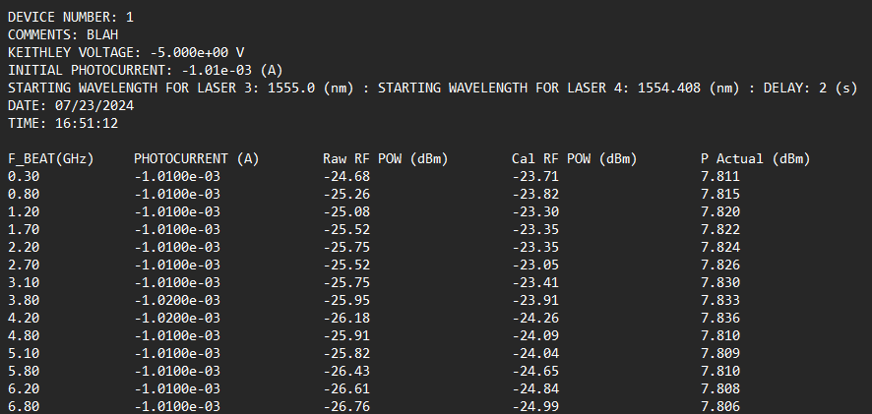
Program Output
.txt Output Data
The .txt output data contains the measured data and a mix of user defined and automatically recorded information in the header:
File name is defined by the user
Device number and trial comments are defined by the user
Keithley voltage and initial photocurrent automatically queried from the instrument
Starting wavelength for laser 3 and 4 recorded after calibrating the first measurement beat frequency, initial user defined delay is added
Time and date automatically added
Data is sorted with the corresponding beat frequency and output in a structured text file format
*The starting wavelength for laser 3 and 4 indicate what wavelength the lasers were set to once the calibration finished and before beginning the measurement loop

Slide 7
Using the Program (Overview)
Steps of Use
Ensure setup is correct (cables, Bias-T, chip, etc)
Turn on all equipment, zero R&S Power Meter using Power Viewer software
Turn on Delta WL mode on Wavelength Meter
Enable lasers, set output power
Turn VOA Power on, do not enable (ensure α is set to 33)
Turn EDFA power switch and key to ON
Set Keithley voltage and current compliance, enable
Ensure correct bias is applied
Turn on EDFA pump (lasers must be enabled first)
Enable the VOA, read the photocurrent on Keithley and adjust α until reaching the desired photocurrent
Enter user inputs and select loss files if applicable, then press the “START” button
After pressing the “START” button, a new window will pop up, prompting the user to enter the device number, comments, and to select the file save path. The program will then begin.
While the program is running, press the “STOP” button to stop measurements and save the data.
At conclusion of the program, the plots will stay open and can be saved or closed.
Common Errors
VISA Address not found
Ensure the GPIB hub is connected (blue USB connector) as well as the R&S power sensor is connected by USB (black USB connector)
Try the program again
Calibration overstepped the threshold
Try the program again with different starting wavelength inputs
Error reading network analyzer/excel file
Ensure the correct file paths are input for the .s2p and .xlsx loss data
Access Code and Related Files
https://github.com/axx2xu/heterodyne

Slide 8
Prior to Running the Program
Additional Requirements if First Time Use on Personal Computer
Driver and Software Installation
Required:
Install NRP Toolkit (To connect with R&S NRP-Z58 power meter)
Install VISA Library Passport for NRP (To connect with R&S NRP-Z58 power meter)
Install R&S Power Viewer (To zero the power meter prior to turning on other equipment)
Optional:
Install NI Max (To view what devices are connected to GPIB addresses)
* Some installation links can be found in the “drivers” file in the GitHub repository

Slide 9
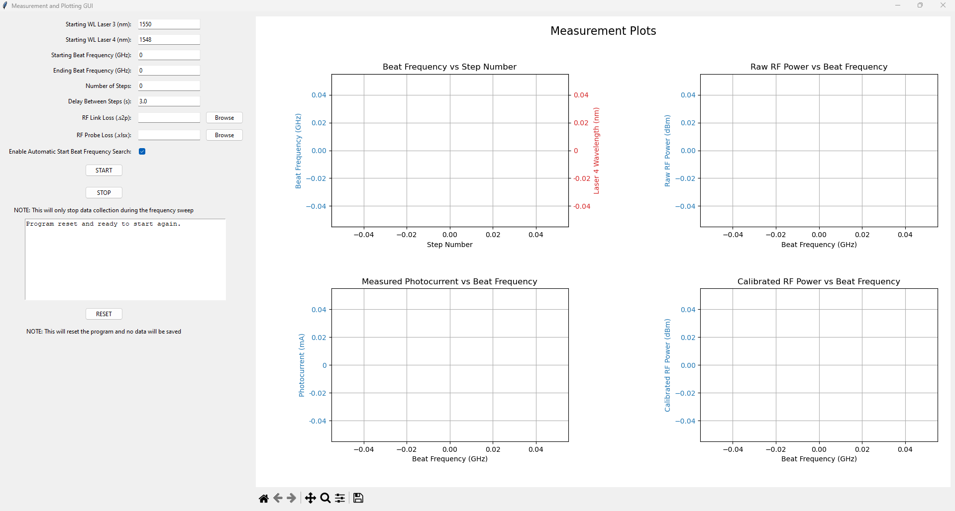

Opening the Program (Ideal)
Ideal Way to Open the Program
The designed and ideal way to run the program is to simply run the distributed .exe file named “heterodyne_automation.exe”
If this runs successfully, the GUI should pop up as shown in the figure
If this does not work, follow the steps on the following slide to run the program through python
Figure: Program GUI When Initially Run
*Opening the program this way should not require installing Python or any dependencies

Slide 10
Opening the Program (Backup)
Backup Way to Open the Program
Ensure that Python is installed on your computer.
Download the “heterodyne_automation.py” and “requirements.txt” files from the GitHub repository into a new project directory.
Navigate to the project directory by opening a terminal and changing to the folder containing your project files.
Create a virtual environment by running: python -m venv venv
Activate the virtual environment: On Windows: .\venv\Scripts\activate On macOS/Linux: source venv/bin/activate
Install the required packages with: pip install -r requirements.txt
Run the program by executing: python heterodyne_automation.py
Figure: Program GUI When Initially Run
*It is important to create the virtual environment to prevent potentially overwriting existing python dependencies on your computer

Slide 11
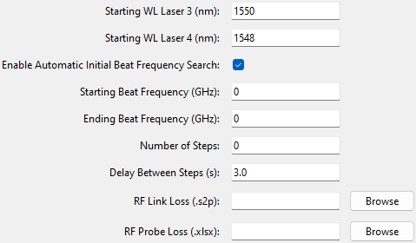
How to Run Program
Input Initial Program Settings
Starting WL for Laser 3
- This will be a stable wavelength and will not be changed by the program; it should be set to your desired wavelength.
Starting WL for laser 4
- This output will be altered by the program to drive the beat frequency. The initial setting should be 2-3nm below that of Laser 3 unless you have already calibrated your starting wavelengths.
If you have already manually calibrated the starting beat frequency, enter the exact wavelengths from the ECL into the inputs of the program, and de-select the “automatic initial beat frequency search” check.
Figure: User Inputs in GUI before Running

Slide 12
How to Run Program (cont.)
Input Initial Program Settings
Starting and ending beat frequency set the range of beat frequencies that the program will parse and take measurements of.
Number of steps
- This will determine the number of steps the program will take between the start and end beat frequency.
Delay between steps
- This will set the delay the program takes between updating the lasers and taking the next measurements. I recommend at least a 3 second delay to ensure accurate measurements.
RF link loss file
- If applicable include existing RF link loss file, it must have .s2p file formatting.
RF probe loss file
- If applicable, include existing RF probe loss file, it must have .xlsx file formatting.
Figure: User Inputs in GUI before Running

Slide 13
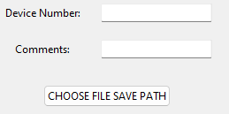
How to Run Program (cont.)
Input Initial Program Settings
Press the “START” button
- A new window will pop up prompting the user to enter the device number, user comments, and save file path
Device number
- Enter the device number or another identification parameter (e.g., serial number).
Comments
- Enter any additional user comments about the device or trial run
Choose file save path
- Search the file directory for the desired save location, then select the save button.
Figure: Pop-up After Selecting “START” button

Slide 14
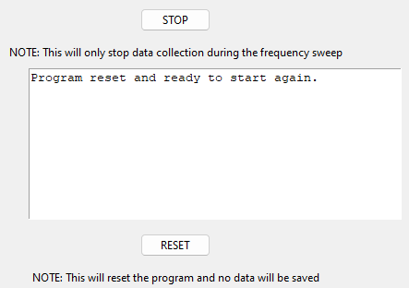

While the Program is Running
Options While Program is Running
Once the measurement loop begins, current measurements will appear in the output window, such as photocurrent, RF power, etc.
To stop the loop during the measurement, press the “STOP” button. Any measurements that have been taken will be automatically saved.
To reset the program, press the “RESET” button. No data will be saved and the program should restart. If the program is not running correctly, it may need to be closed and re-opened.
The plots and data will automatically save to the path file selected during the initial program setup. If you would like to save the plots again, press the save button pictured to the right and select the desired file path.
Figure: Output and buttons while running

Slide 15
Suggested Settings
Wavelength and Delay Inputs
Over trials that have been run, center wavelength of 1555nm (laser 3 set to 1555nm and laser 4 calibrated to match) generally has best results
When lasers 3 and 4 are set near 1555nm, the wavelength meter typically reads near 1550nm, which indicates the lasers are ~ 5nm in wavelength lower than what they are set to on the ECL.
Laser 4 typically has an actual wavelength of ~ 1nm below that of laser 3. If you are using the calibration setting to search for the starting beat frequency, I suggest setting the laser 4 wavelength 1-2nm below laser 3 to avoid accidentally overstepping the calibration loop
User-input delay between updating lasers and remeasuring of over 3 or more seconds typically offers best results
Previous beat frequency vs. step plots are shown on following slides and highlight typical areas of issue, notably:
Common issues when laser 4 is set between 1544.1 – 1544.5nm
Common issues when laser 4 is set between 1549.5-1549.9 nm
Common issues when laser 4 is set between 1554.9-1555.2 nm

Slide 16
Beat Frequency vs. Step Graphing for Different Center Wavelengths
Center wavelength 1545nm: Inconsistency for all delay periods, less inconsistency with longer delay. Common issues when laser 4 is set between 1544.1 – 1544.5nm
Center wavelength 1550nm: Inconsistency for all delay periods, less inconsistency with longer delay. Common issues when laser 4 is set between 1549.5-1549.9 nm
Center wavelength 1555nm: Inconsistency for all delay periods, longer delay may have less consistency but were still inconsistent. Common issues when laser 4 is set between 1554.9-1555.2 nm
Conclusion
Of the three tested center wavelengths, 1555nm appears to be the most consistent. Results may differ significantly between periods where the instruments have been turned off. Consecutive measurements may also be inconsistent with little delay between them. The measurements seem to be more accurate as the instruments have been on for longer periods of time. Recommend to test different center wavelengths and delays to find what is most accurate at the time before taking notable measurement recordings.

Slide 17
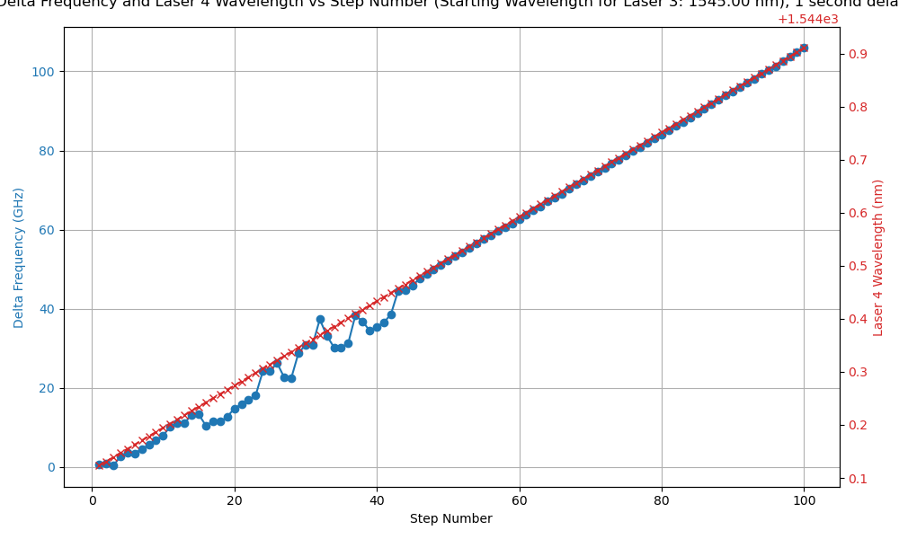
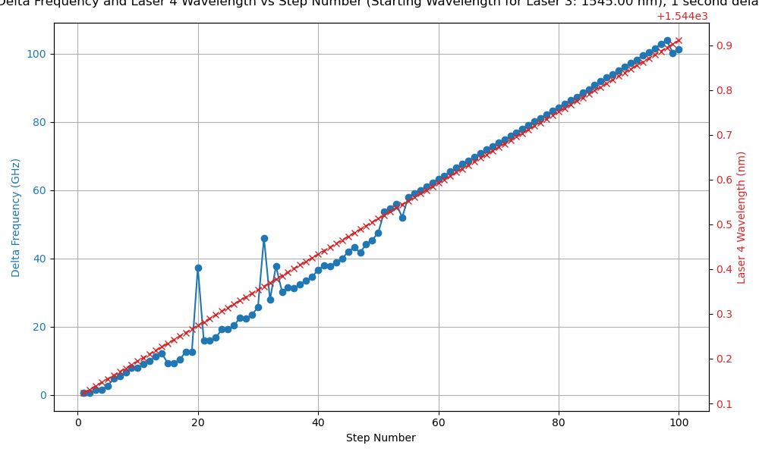
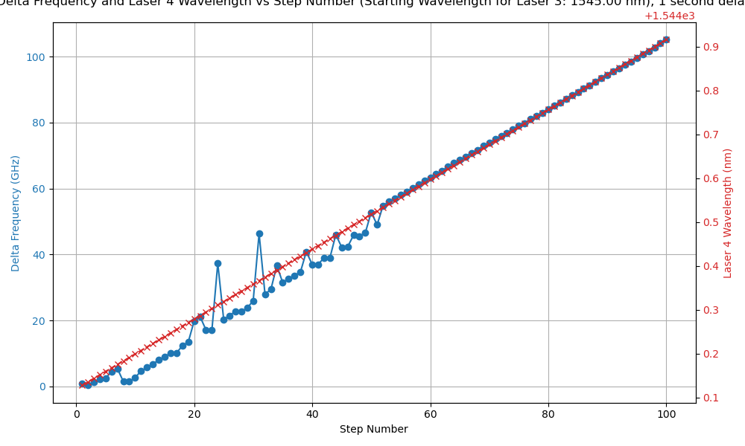
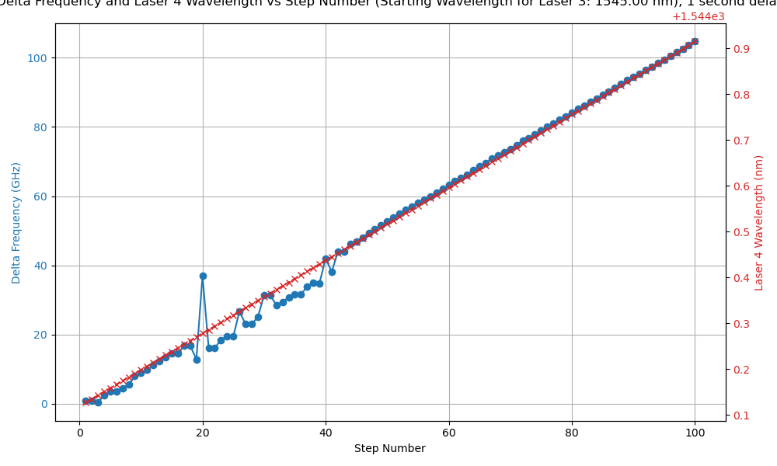
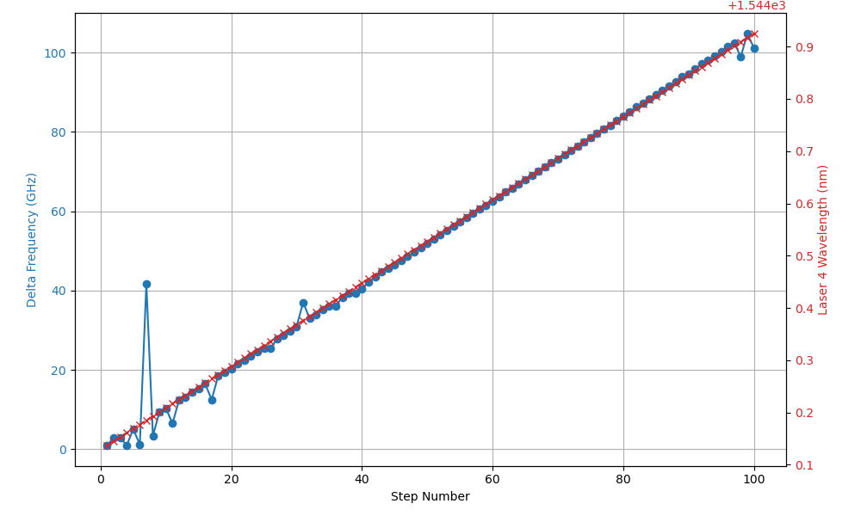
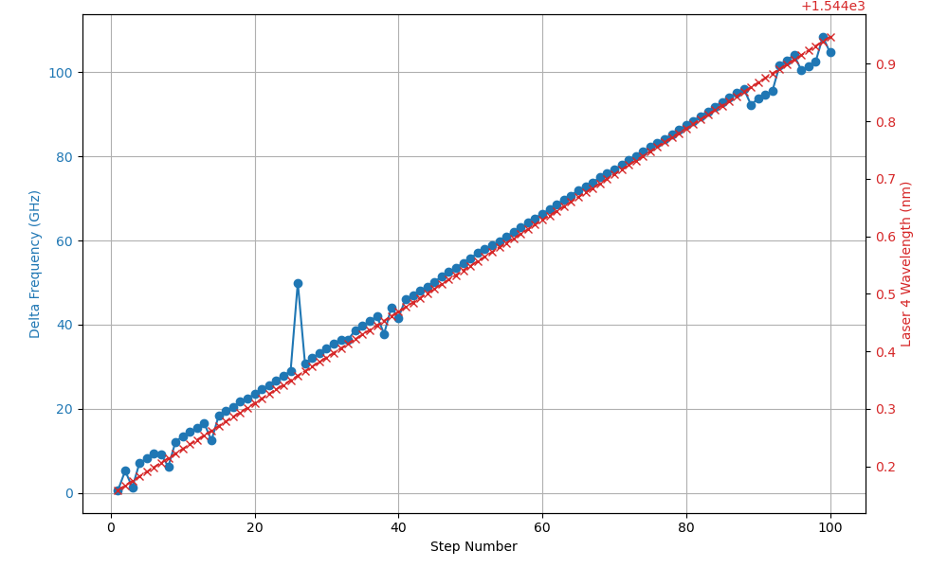
Beat Frequency vs. Step Graphing – 1545 nm
1s Delay
1.5s Delay
2s Delay
Issues common when laser 4 is set between 1544.1 – 1544.5nm

Slide 18
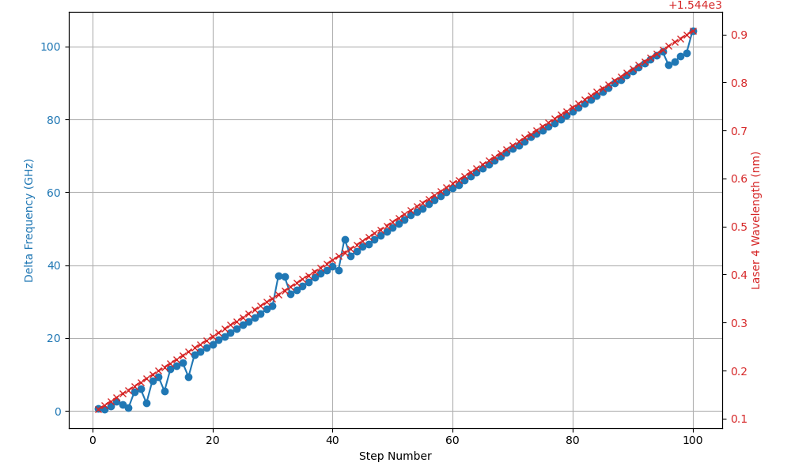
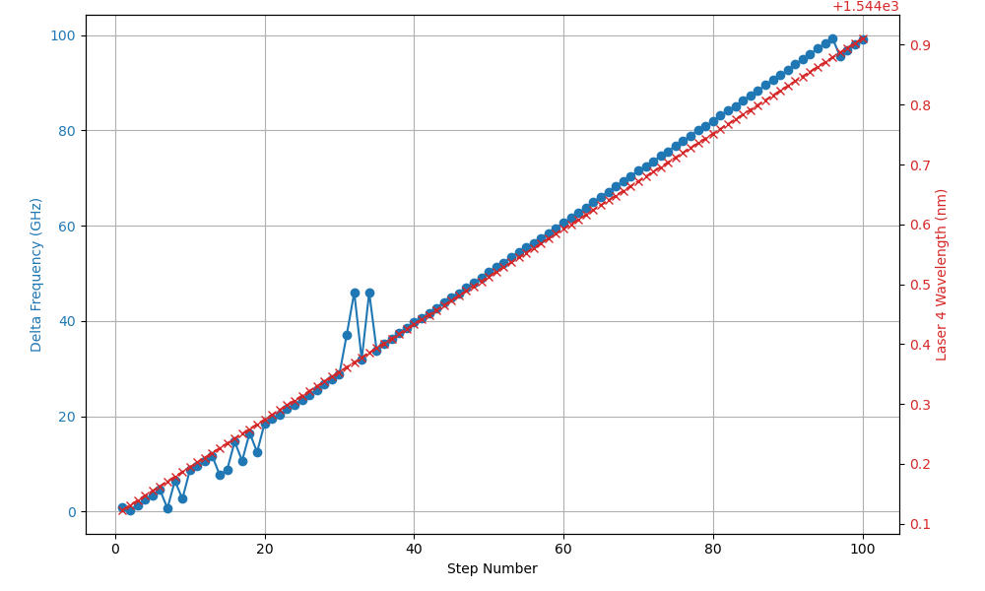
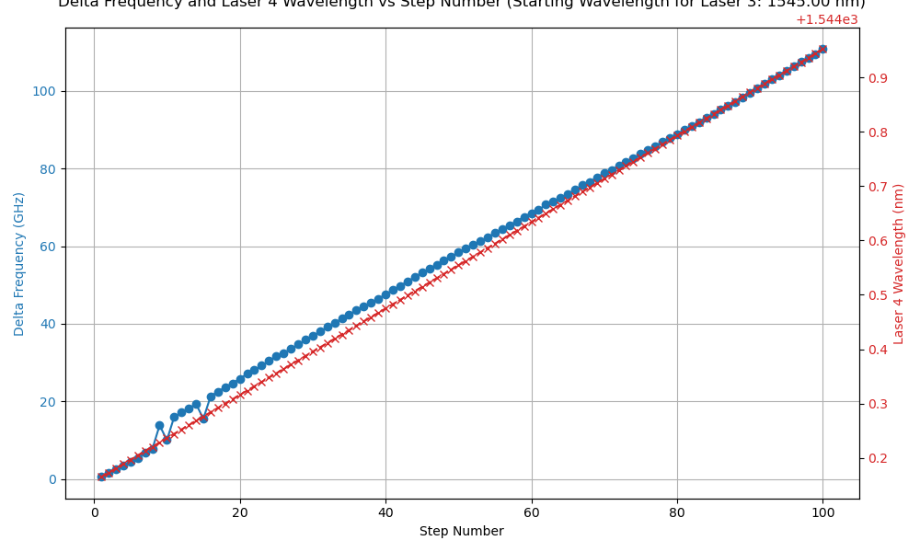
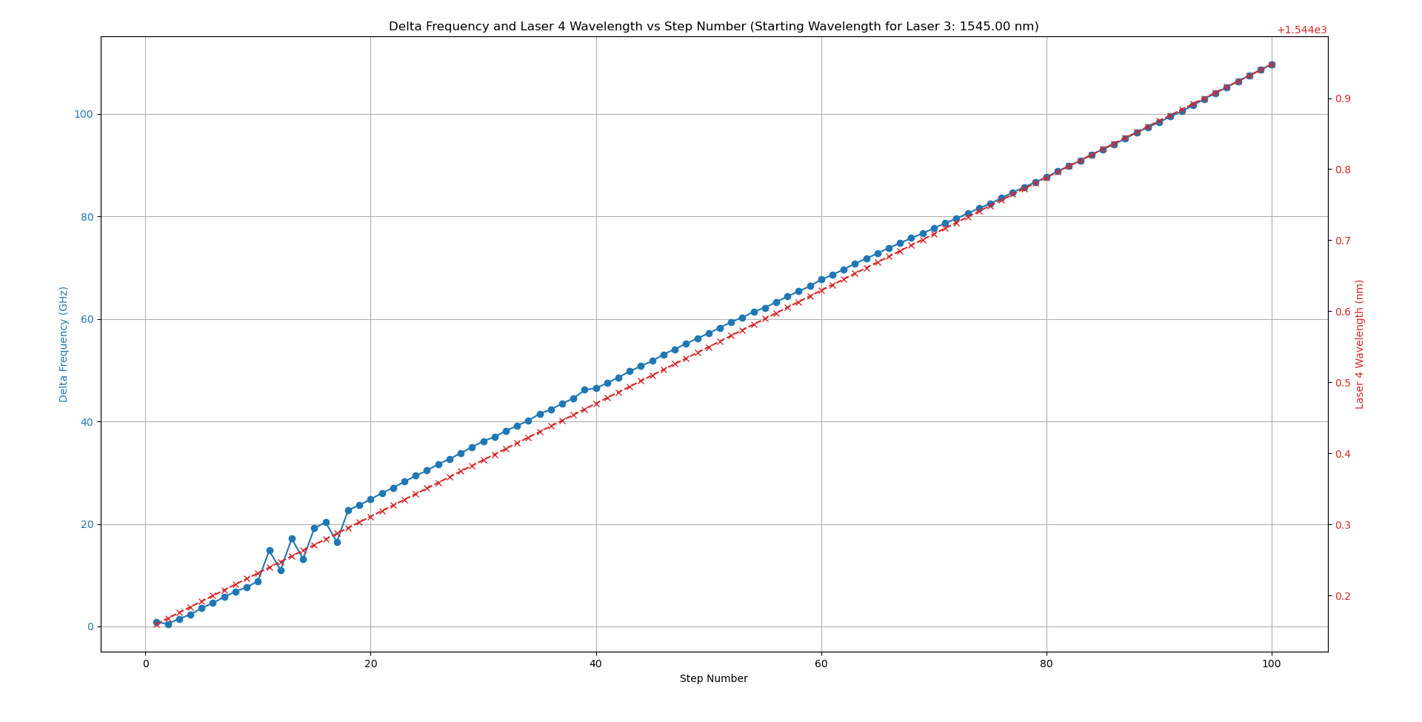
Beat Frequency vs. Step Graphing – 1545 nm
3s Delay
4s Delay

Slide 19
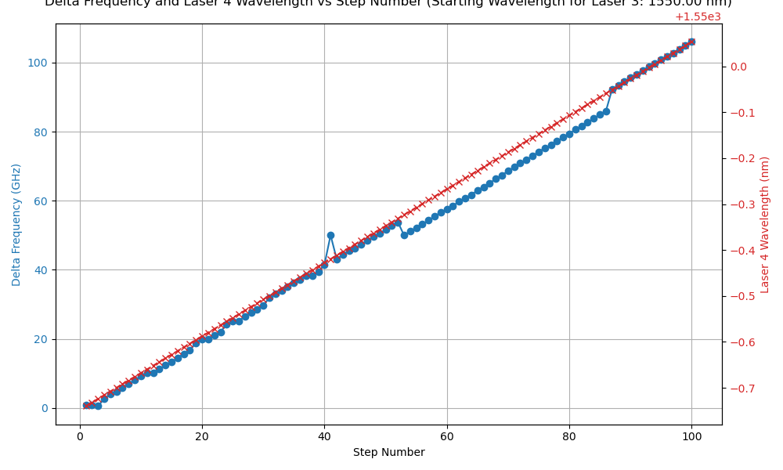
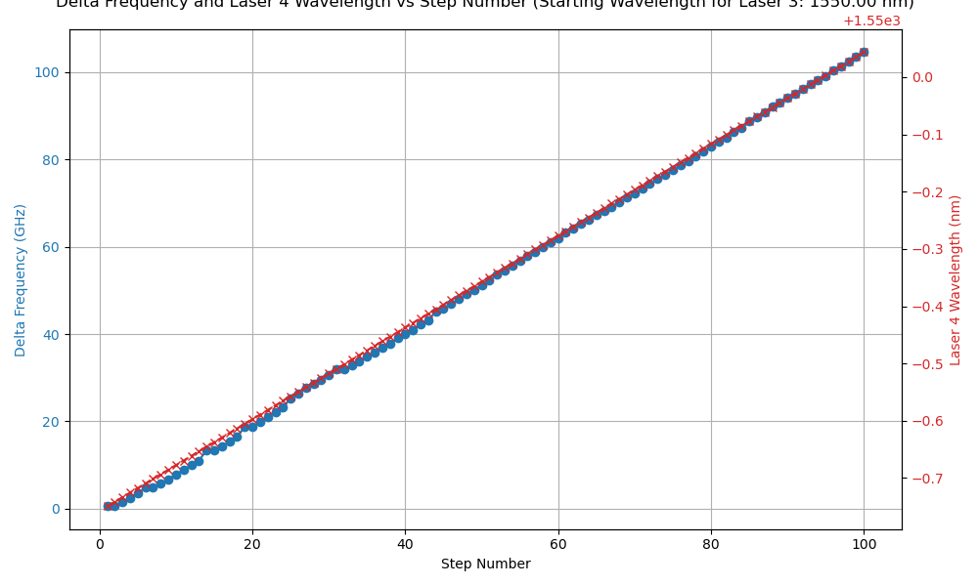
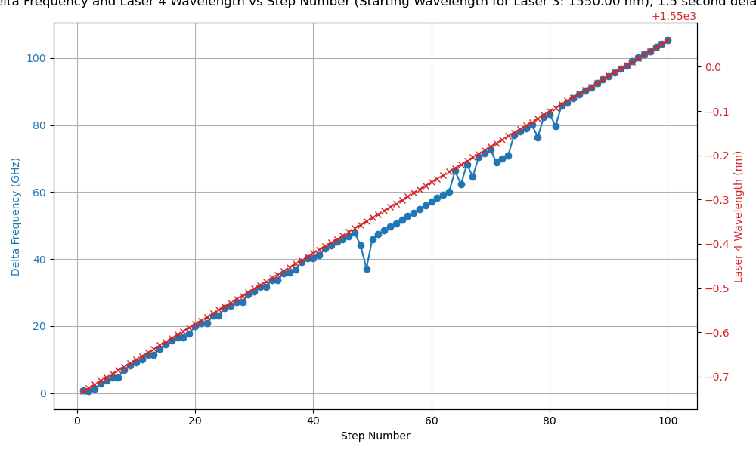
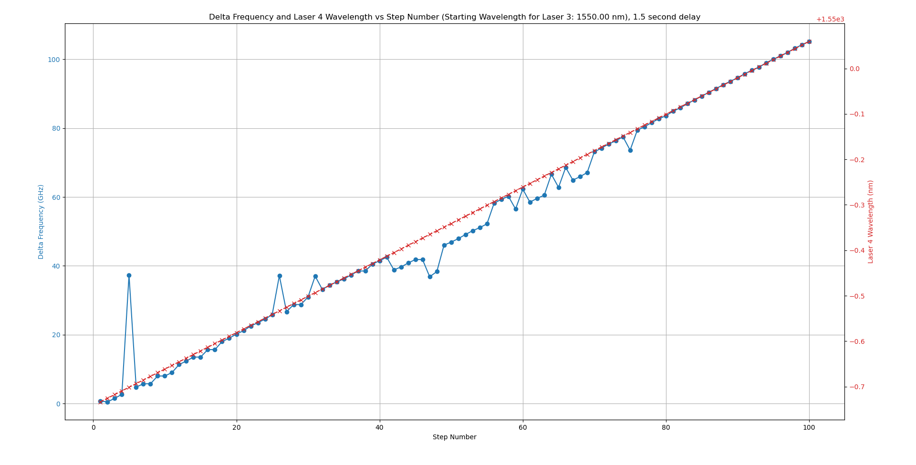
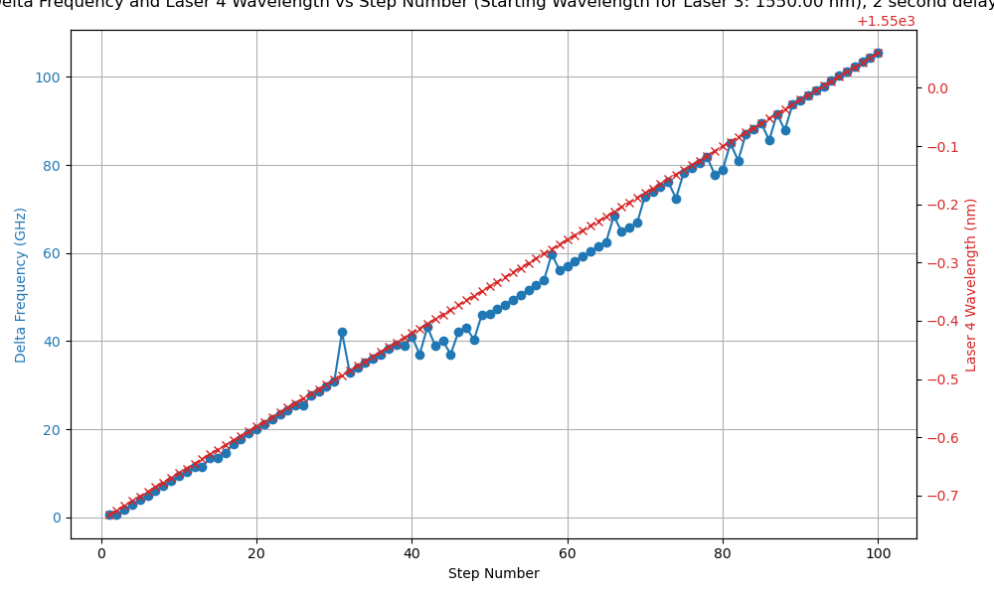
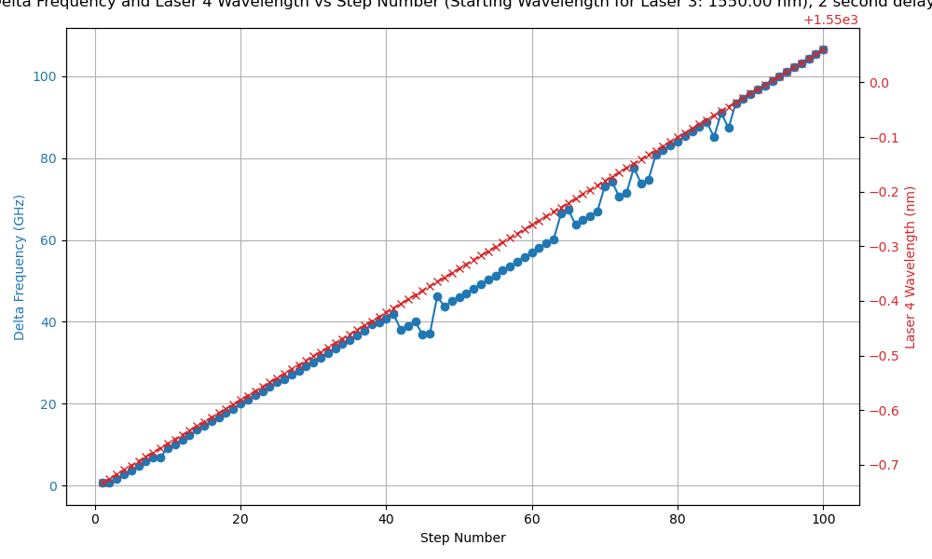
Beat Frequency vs. Step Graphing – 1550 nm
1s Delay
1.5s Delay
2s Delay
Issues common when laser 4 is set between 1549.5-1549.9 nm

Slide 20
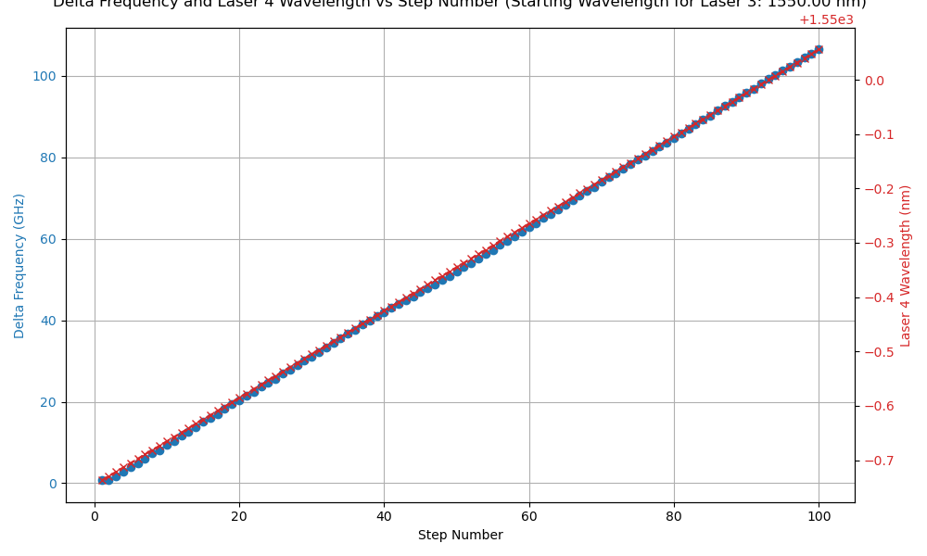
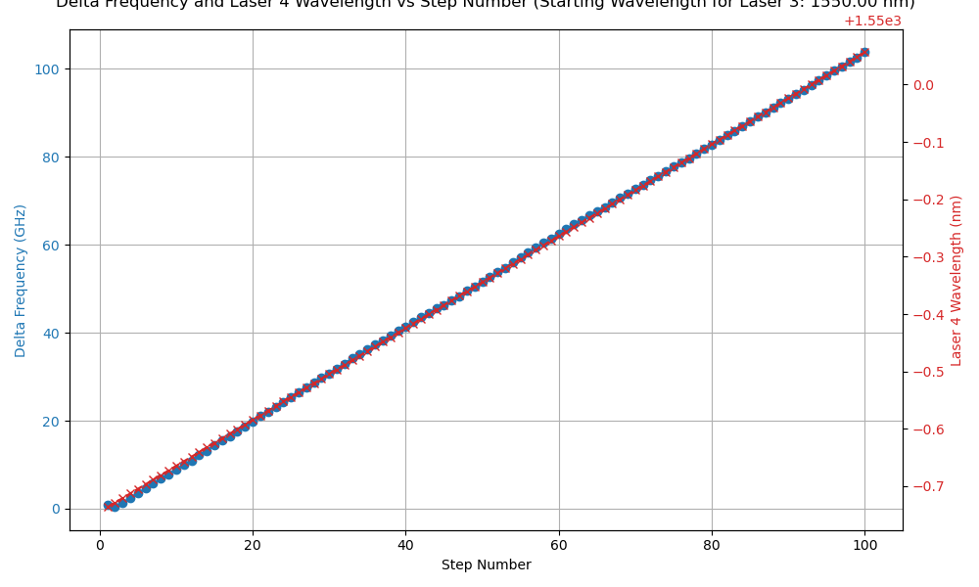
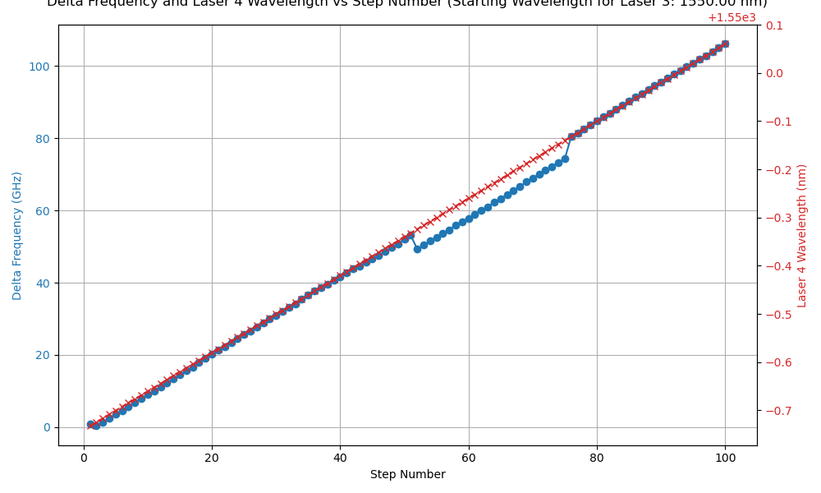
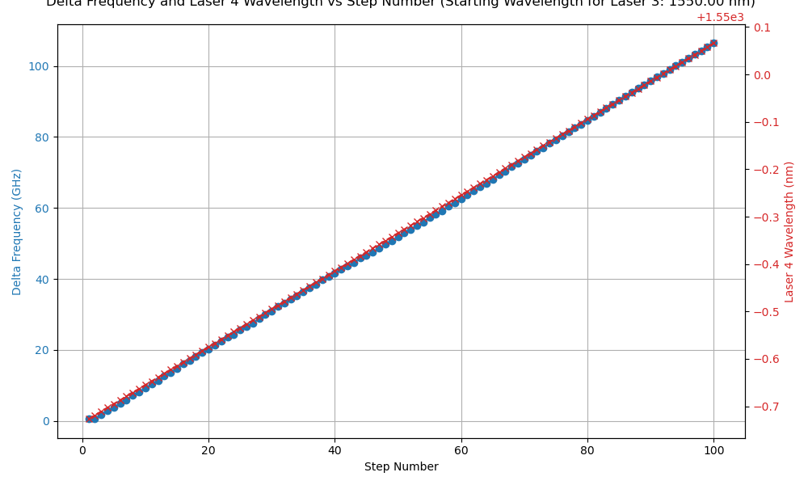

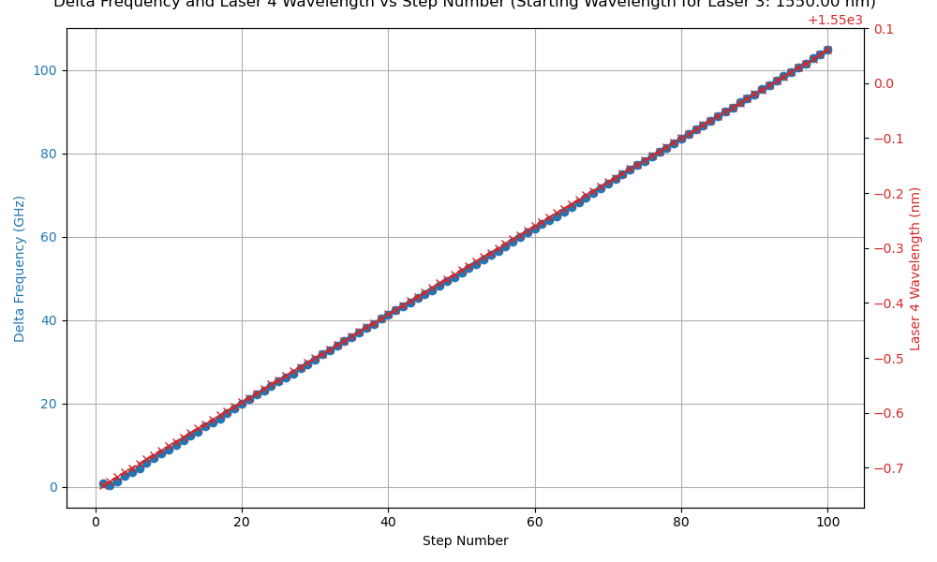
Beat Frequency vs. Step Graphing – 1550 nm
3s Delay
4s Delay
5s Delay
Issues common when laser 4 is set between 1549.5-1549.9 nm

Slide 21
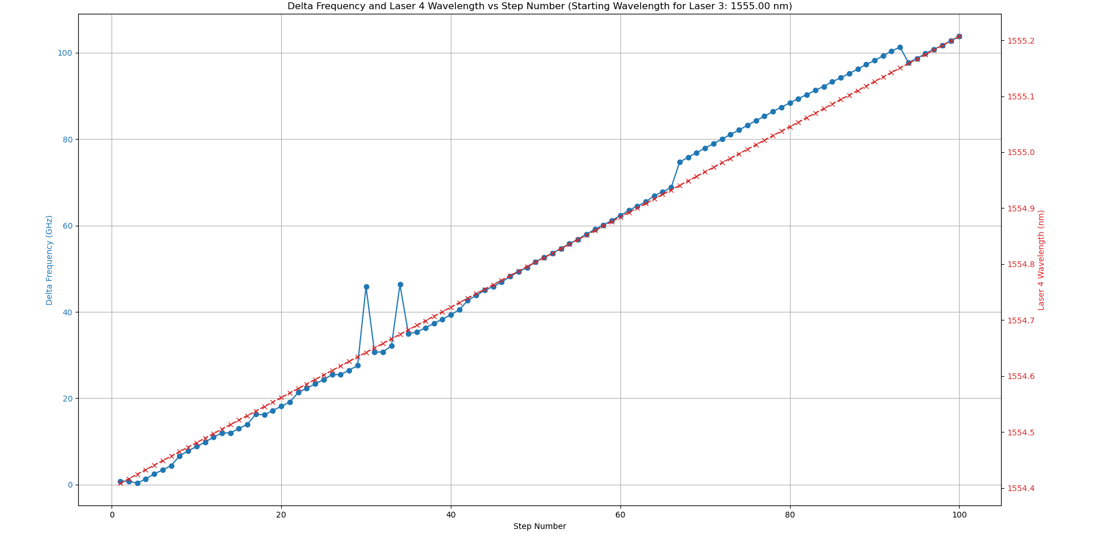
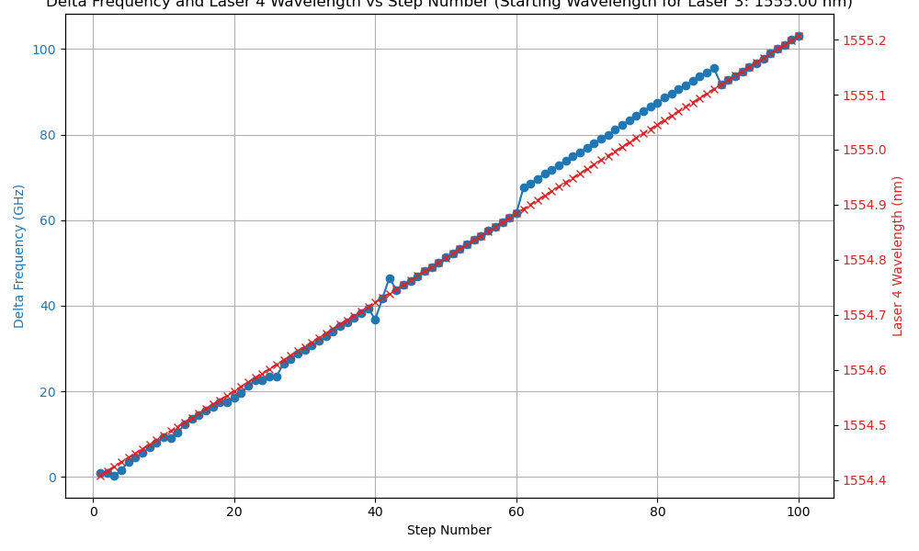
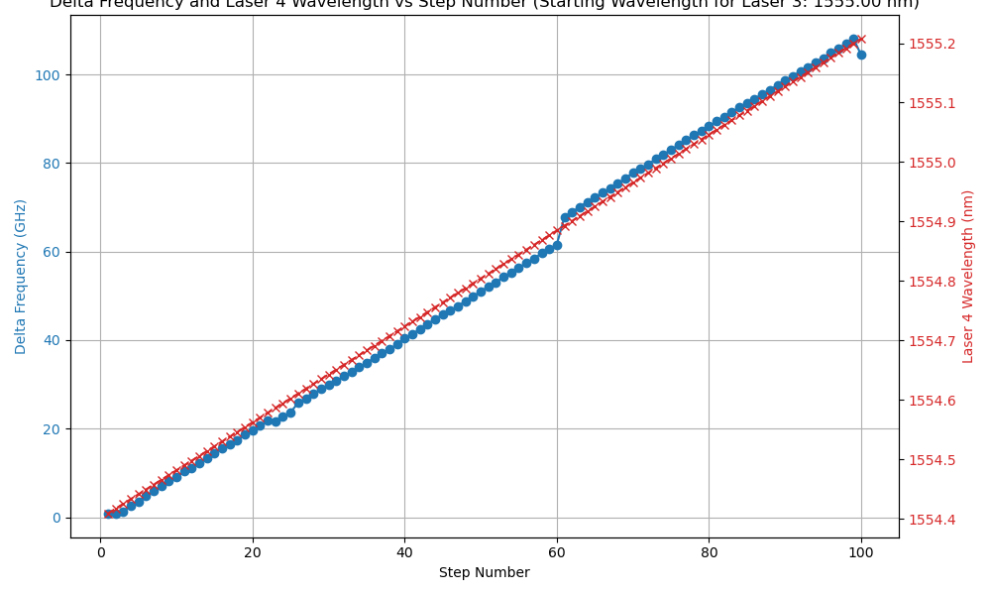
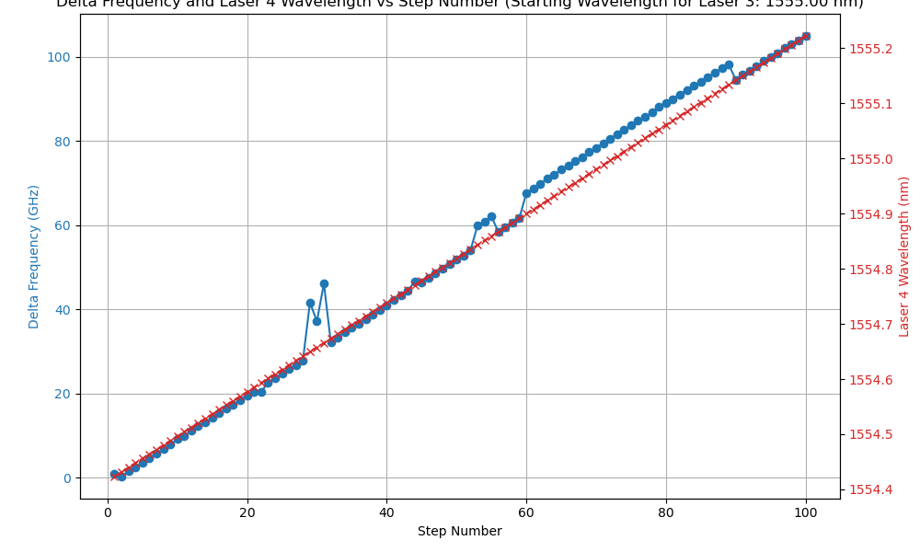

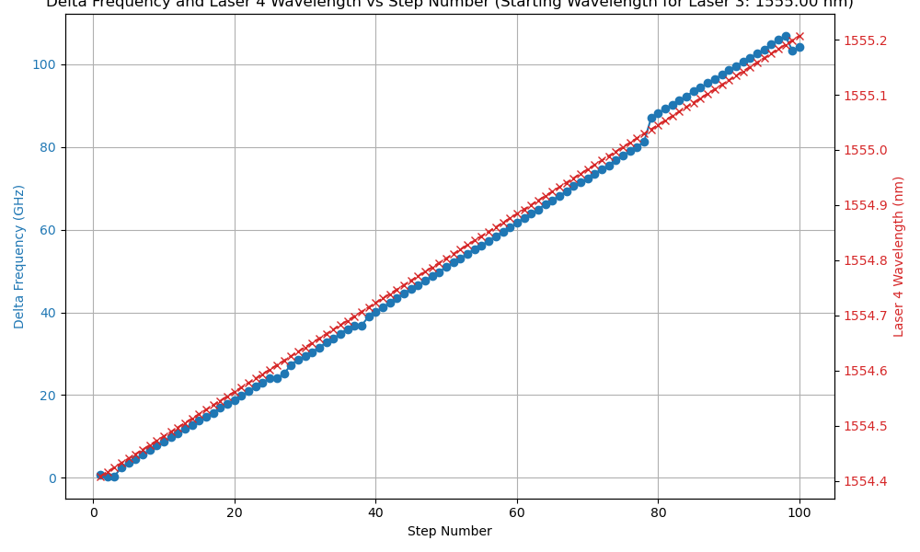
Beat Frequency vs. Step Graphing – 1555 nm
1s Delay
2s Delay
3s Delay
Issues common when laser 4 is set between 1554.9-1555.2 nm

Slide 22
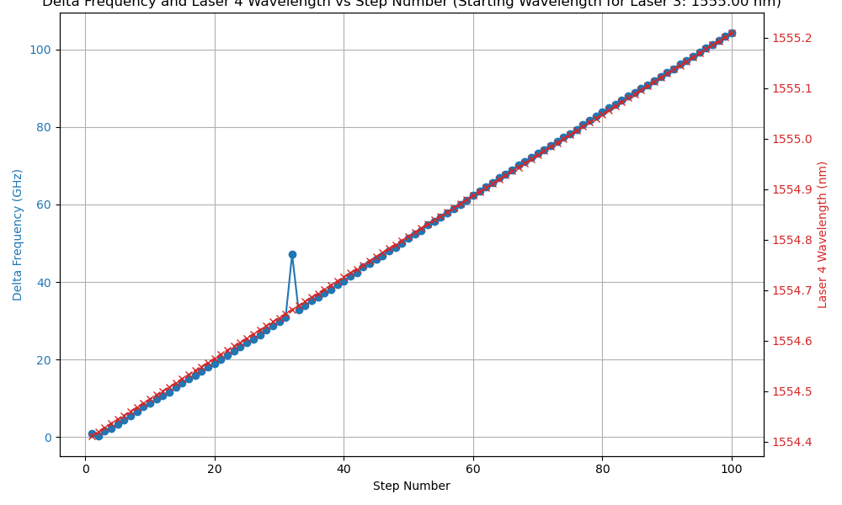
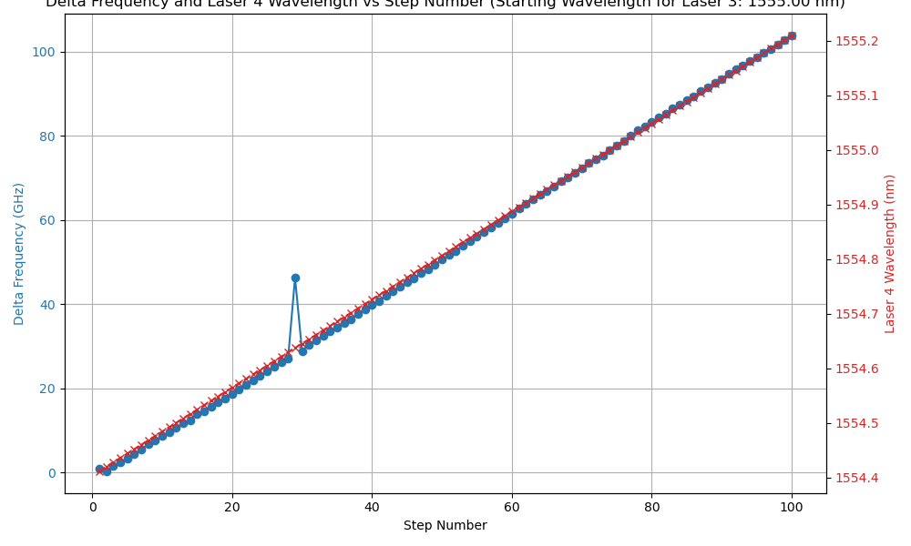
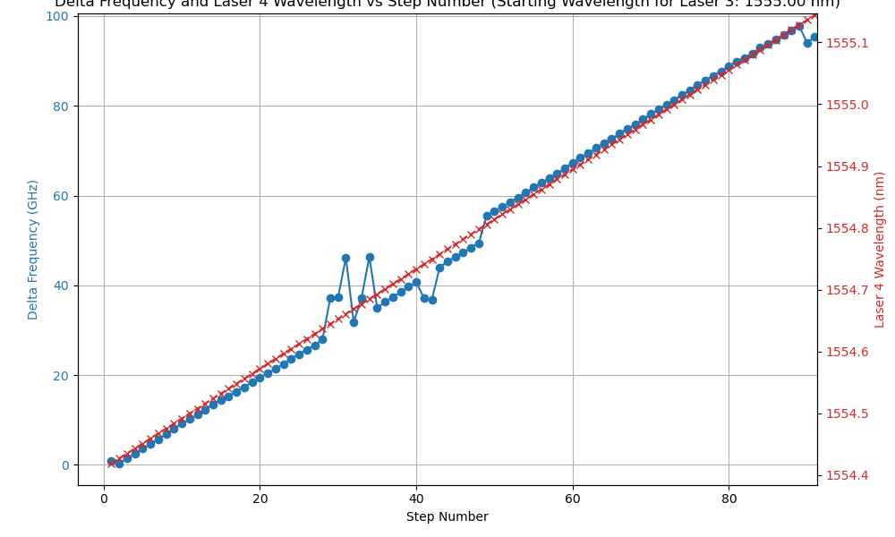

Beat Frequency vs. Step Graphing – 1555 nm
4s Delay
5s Delay

Slide 23
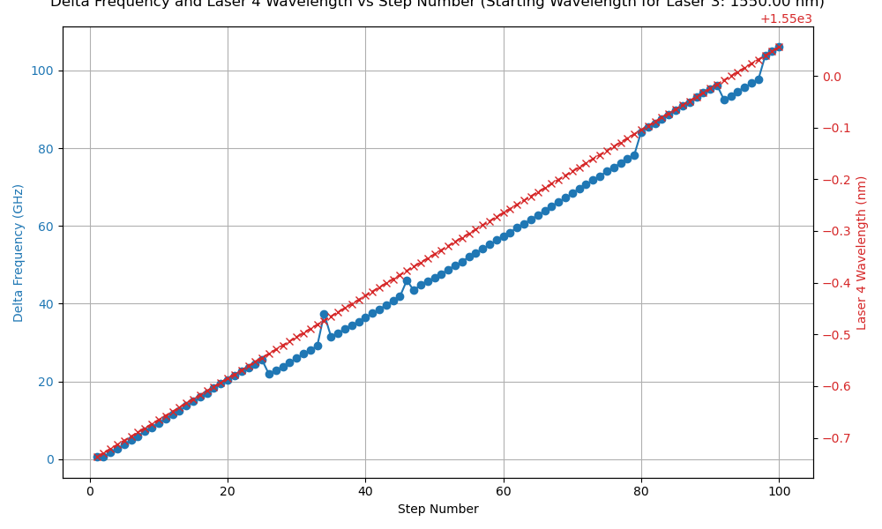
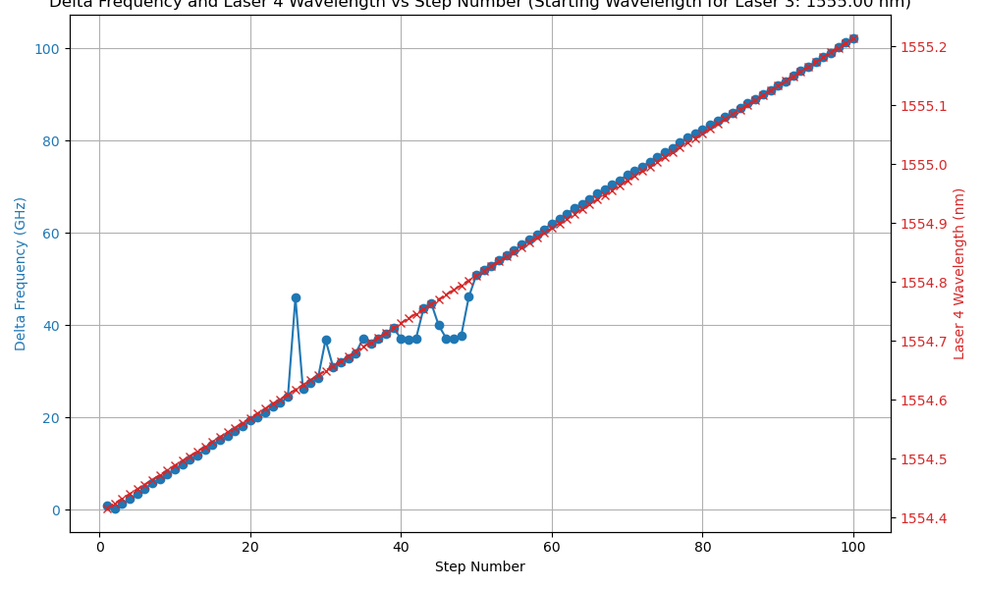
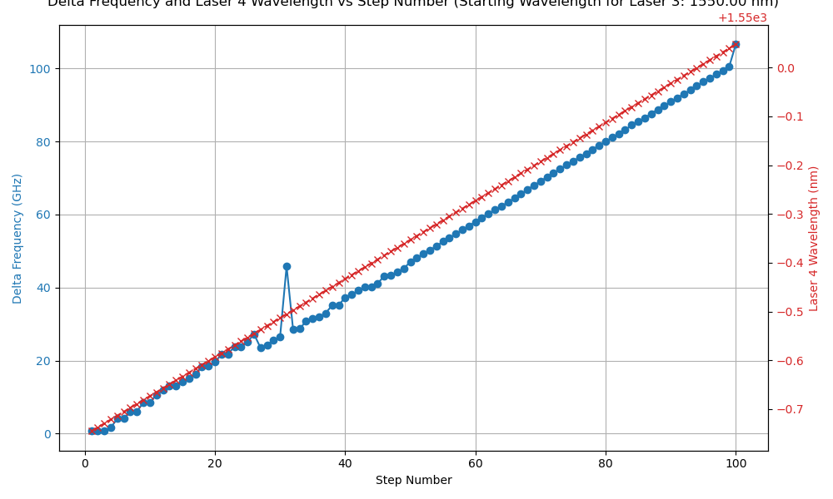
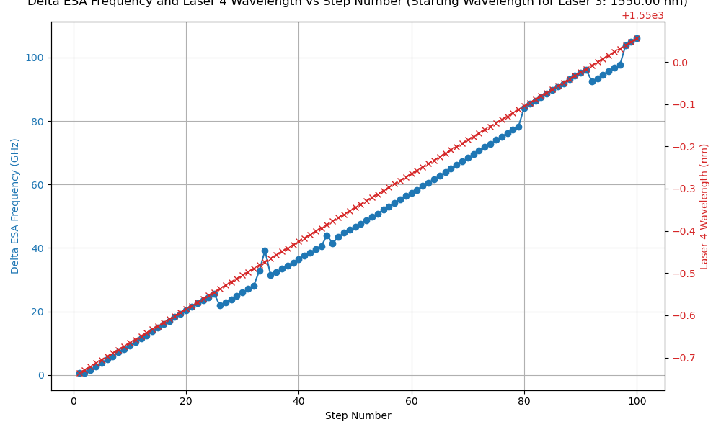
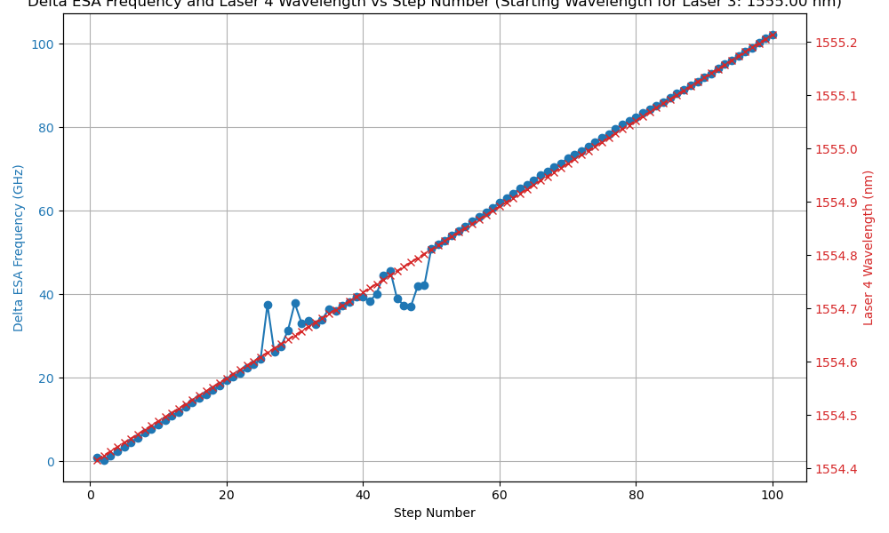
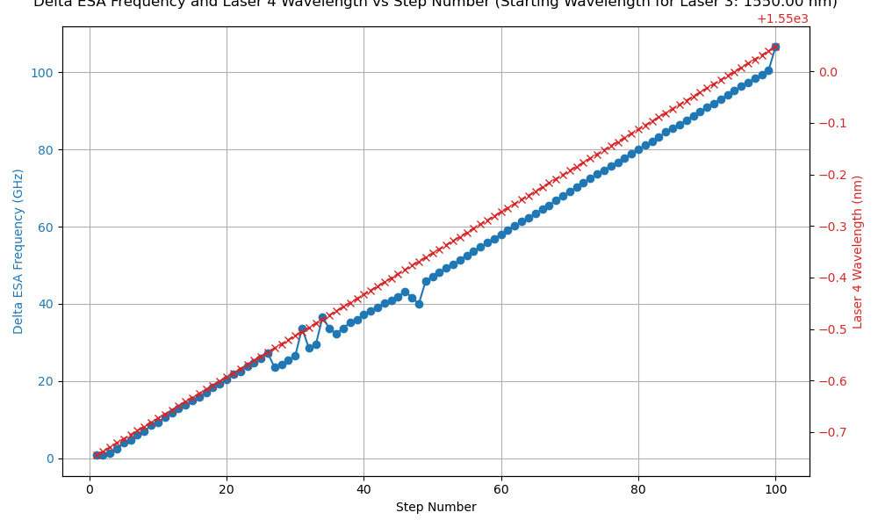
Single Point ESA vs. Averaged
Single Point ESA Measurement
Averaged ESA Measurement

Slide 24
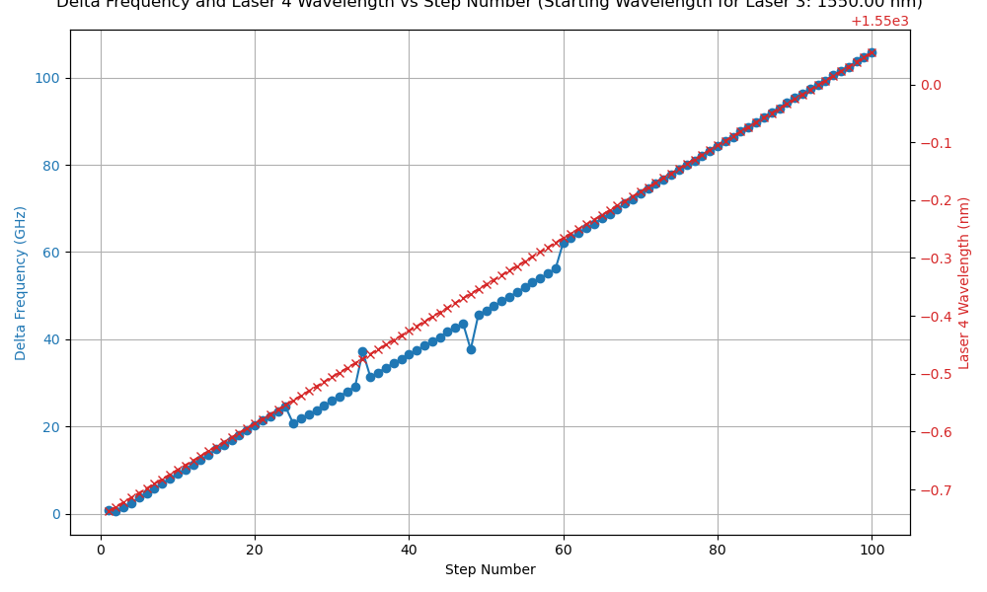
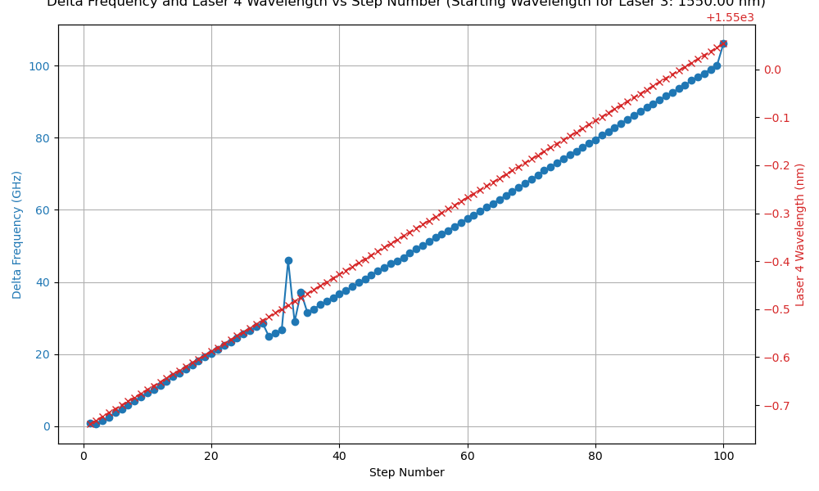
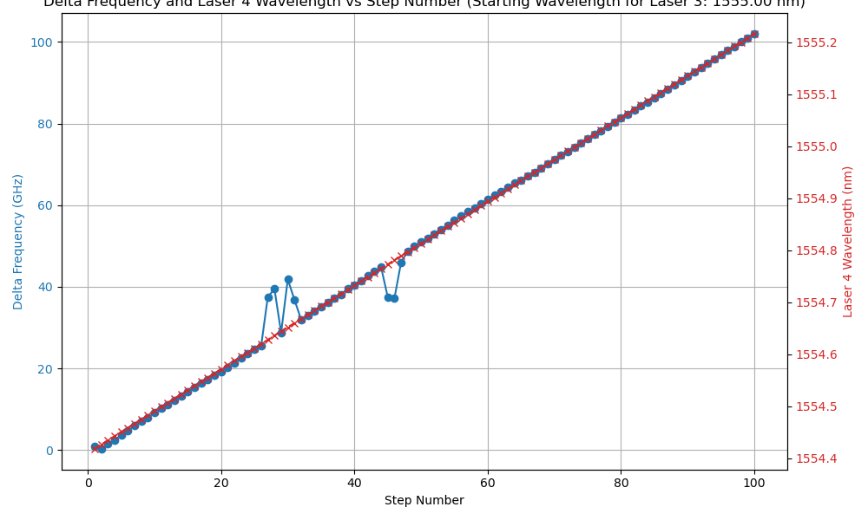

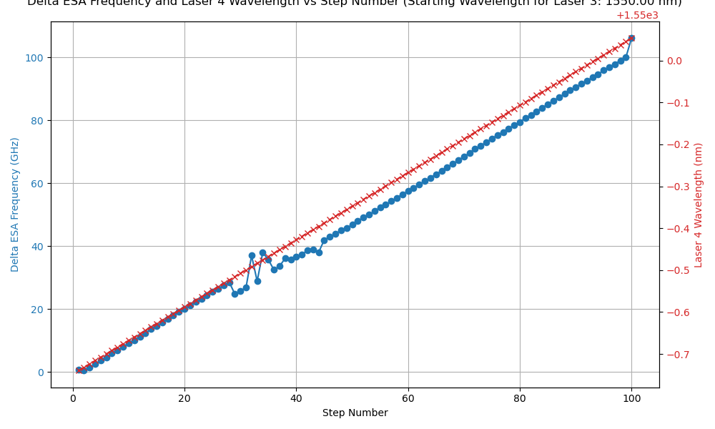

Single Point ESA vs. Averaged
Single Point ESA Measurement
Averaged ESA Measurement

Slide 25
Single Point ESA vs. Averaged
ESA readings are automatically averaged from the instrument
Little difference was found adding additional averaging from multiple query points for the ESA reading compared to single point reading.

